Slide 1
Data Structures
Carrano & Henry,
Chp. 1 (pp. 29 – 50)
Topic 2 – Bags

Slide 2
Design

Slide 3
Abstract Data Types
Abstract data types (ADTs) are a powerful tool to make programs and data structures adaptable
An ADT is a specification for a group of values and the operations on those values that is defined conceptually and independently of any programming language
A data structure is an implementation of an ADT within a specific programming language
As you become more experienced, you want to think of programming as problem solving, and not as an exercise in coding in a specific language

Slide 4
The ADT Bag
A finite collection of objects in no particular order
Can contain duplicate items
Possible operations
Get number of items
Check if empty
Add / Remove items

Slide 5
Specifying a Bag
Describe its data and specify in detail the methods (name them, identify params, define return types, write comments)
What are some of the methods that we would want to include?

Slide 6
Design Decisions
What do we do for unusual conditions?
Assume it won't happen
Ignore invalid situations
Guess client's intention
Return value that signals a problem
Return a boolean
Throw an exception

Slide 7
Creating an Interface
To implement our ADT Bag type in Java, we can create an Interface
Use a generic type so that we can hold any type of object in the Bag
Declare all methods that we want any implementation of a Bag to support
BagInterface.java shows the interface

Slide 8
Using the ADT Bag
Once the BagInterface is defined, we can think about how to use it…
Notice, we do not have a Bag class (or any class) that implements our new interface
Nor did we decide what our Bag will hold
But we can think about how our Bag could be used and plan and design tests based on it

Slide 9
Example: Shopping Cart
Consider the example class OnlineShopper.java
A shopping cart is a good example of a bag
We add and remove items
We don't care what order the items are in
We don't know ahead of time what the size will be
Again, we can envision how this shopping cart should work, without a complete implementation

Slide 10
Example: Piggy Bank
Another example is a piggy bank
A Bag is a fitting representation
The piggy bank holds coins but does not organize them
Duplicate coins (i.e., of the same denomination) are possible
Actually can even be simpler as there are only three operations (add a coin, remove a coin, check if empty)
Assuming we have a class Coin, let's see how this will look

Slide 11
Abstracting Out the Implementation
At this point, you may feel uncomfortable writing a program that depends on code that does not yet exist
Get used to it!
You have to get comfortable with compartmentalizing and working on separate modules
You will not be able to write every line of code that goes into a system
And you do not have to wait until the last minute to test and figure out how it will be used

Slide 12
Abstracting Out the Implementation
Think about a vending machine
A user can only perform tasks that the machine's interface allows
Cannot access the inside of the machine, but knows how to use it
Even if the inside of the machine changes, the user can still interact with the machine via the interface and use it

Slide 13
Observations about the ADT Bag
You can perform tasks specific to the ADT
Must adhere to the specifications of the operations of the ADT (required parameters, pre-conditions, etc)
Cannot access data inside the ADT without the ADT operations
You can use the ADT, even if you don't know how the data is stored
Usable even with a brand new implementation

Slide 14
The ADT Set
A set is a special kind of bag, where duplicate entries are not allowed
How would we design such a data structure?
We can use the basic framework for the bag, but need to make some adjustments…
add / remove need to be changed so each entry is unique
getFrequenceOf is not needed
SetInterface.java shows an implementation of a Set

Slide 15
Implementation

Slide 16
Implementing the Bag
In our previous discussion, we focused on the properties and operations of our bag
We did not make any assumptions about how the data would be organized
We will look at various possible implementations, falling into two categories:
Array based (chp. 2)
Linked list based (chp. 3)

Slide 17
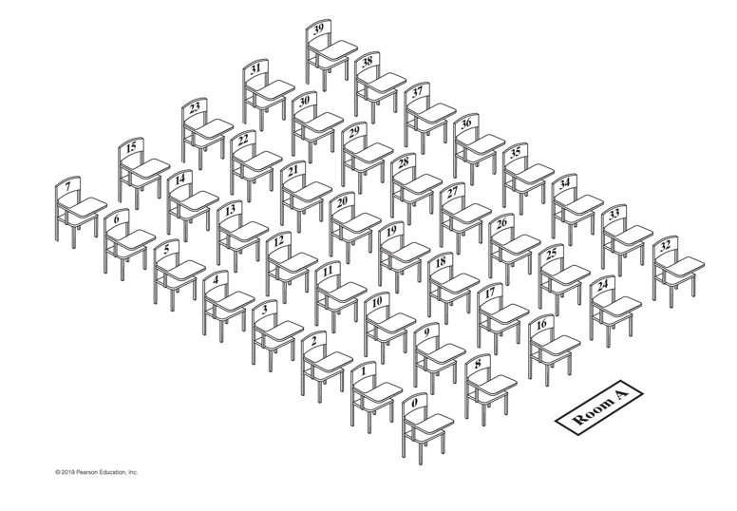
Using a Fixed-Sized Array
The first implementation will use a fixed-sized array, meaning the bag can be full

Slide 18
Using a Fixed-Sized Array
How will we manage this implementation?
Suppose we establish a rule that entries occupy continuous slots, starting from 0
Given this particular implementation of the bag, how should the different operations work?
Add?
Remove?
Anything else?

Slide 19
Data Fields
When implementing a larger class, don't attempt to code the entire class before testing
First identify the data properties that are needed
The array that the entries are stored in
The number of entries in the bag
A constant value for the default capacity

Slide 20
Core Methods
Then, identify the core methods that you can implement AND test before moving on to the rest of the class
What are the core methods for our array-based bag?
Constructors
Add
isArrayFull
toArray

Slide 21
Other Methods
Finally, work on the other methods
getCurrentSize
Remove
Clear
getFrequencyOf
contains

Slide 22
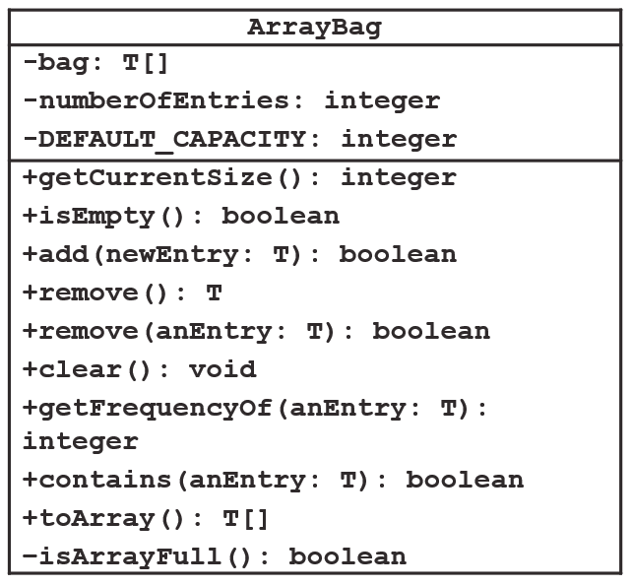
Bag Class Diagram

Slide 23
Implementing the Core Methods
When we start to implement the ArrayBag class, we want to focus on and test the core methods first
Good to start by outlining the class, declare headers for all the methods, write out the header comments
Then take each core method in turn and make implementation decisions

Slide 24
The add Method
What happens when we add a new entry into our fixed-sized array bag?
We check to make sure that the bag is not full (if it is full, return FALSE)
We add the new entry into the next available spot
We increment the number of entries
Return TRUE

Slide 25
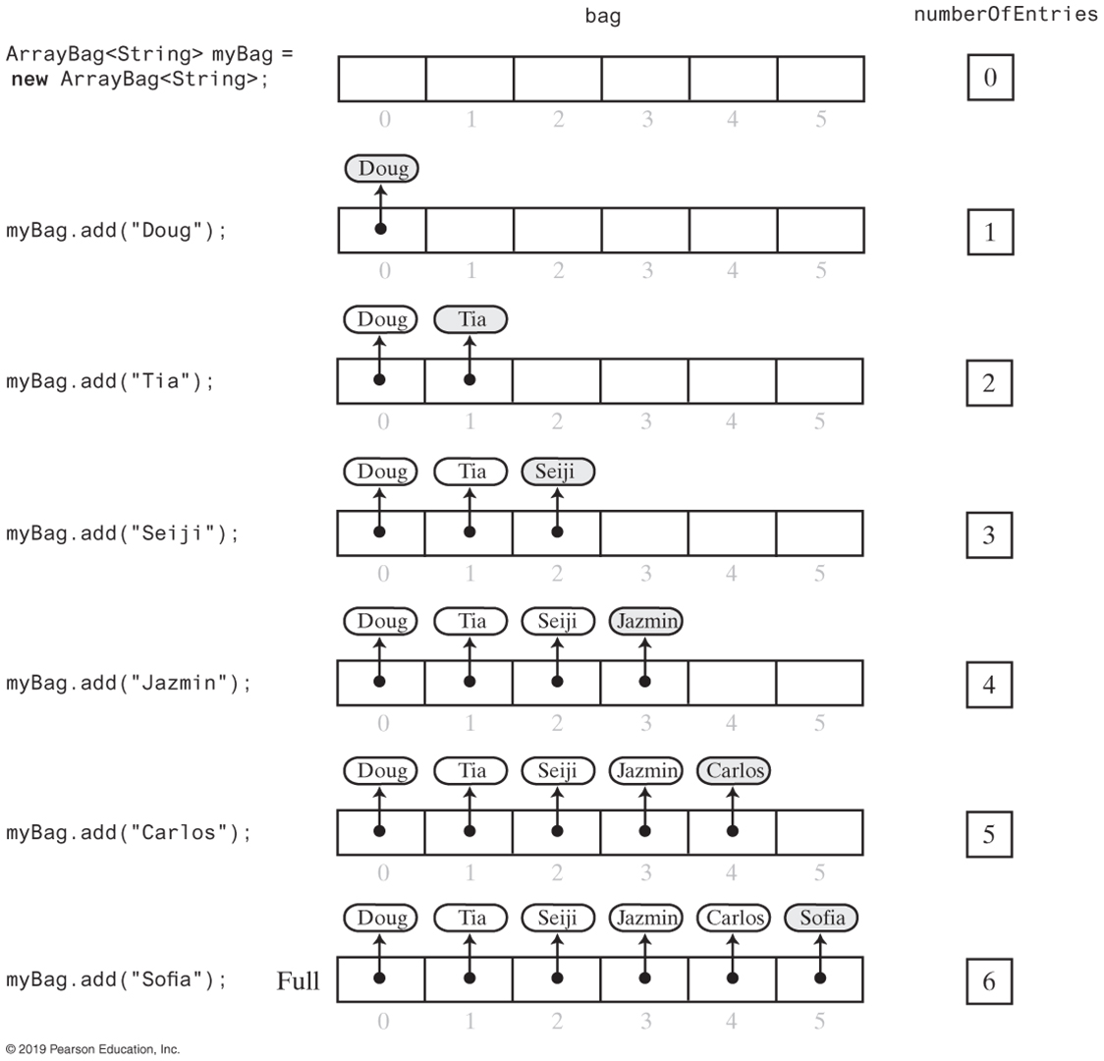
The add Method

Slide 26
The add Method

Slide 27
Making the Implementation Secure
It is good practice to include checks for anticipated errors
Validate input data and arguments to a method
We can refine the implementation by adding two additional data properties
MAX_CAPACITY
integrityOK - flag value we can use to throw exceptions

Slide 28
Making the Implementation Secure
With the new properties,
Revise constructor to throw an exception if attempting to create a bag larger than MAX_CAPACITY
Define a checkIntegrity() private method to throw an exception if the integrityOK flag value is false
We can call checkIntegrity() before attempting to add to the bag

Slide 29
Testing the Core Methods
With the core methods completed, we should test them out
Recall that in order to implement an interface, we must have definitions for each of the contracted methods
For the time being, we can create stubs for the remove and clear methods

Slide 30
Testing the Core Methods
We want to test the constructor, the add method, and making sure our capacity check works
Create an empty bag with default capacity; add some elements; call helper testAdd method to add more (should pass)
Create a bag with capacity of 7 with 7 entries; call helper testAdd method to add more (should fail)
Define a displayBag() method to show the state of the bag

Slide 31
Implementing More Methods
Once we confirm that the core methods work, we can add more to our implementation
isEmpty
getCurrentSize
getFrequencyOf
contains

Slide 32
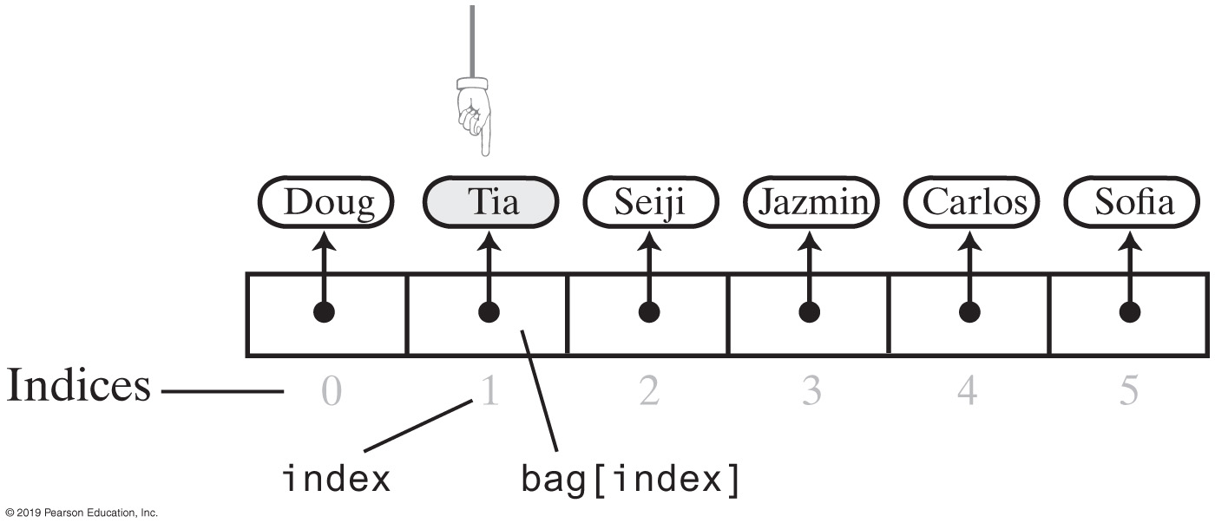
Implementing Removal Methods
Removing an entry from the bag requires some upkeep
For the default remove method (that takes no parameters), we can just decide to remove the last entry (easiest to maintain)
But if we remove a specific entry, we are going to have to move entries to close the vacated slot

Slide 33
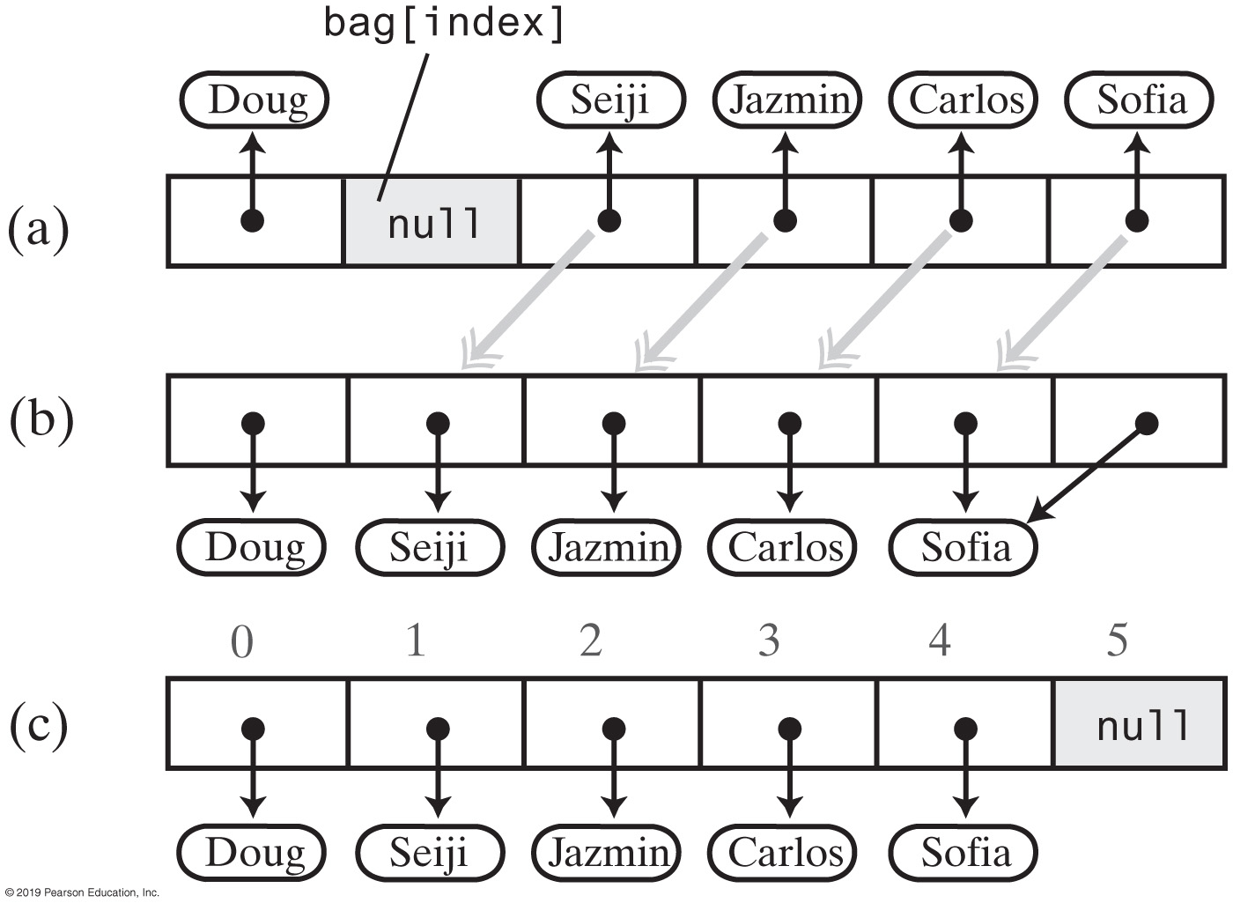
Implementing Removal Methods
Option 1: Slide everything over

Slide 34
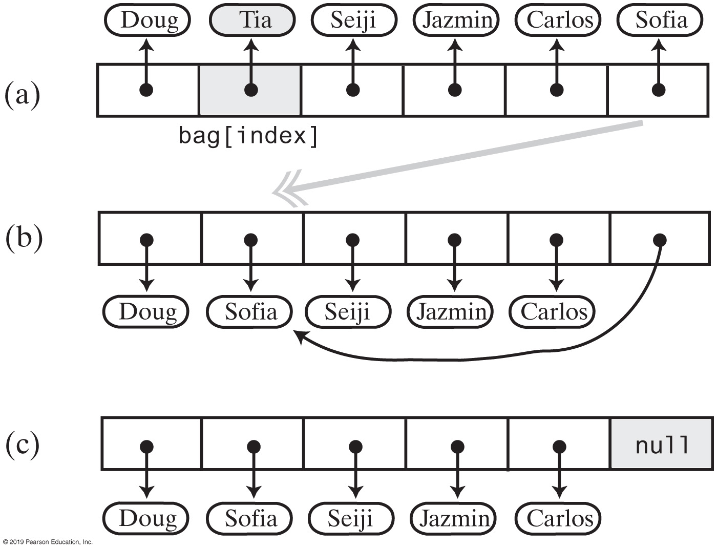
Implementing Removal Methods
Option 2: Swap last entry into vacated slot

Slide 35
Implementing Removal Methods
We want to leverage the code we write so it can be reused
remove() – remove the last entry
remove(int givenIndex) – remove the given entry, swap in the last entry
remove(T anEntry) – find index of anEntry, call remove(i) with the index
Can create a private helper method getIndexOf(T anEntry)
This can also be used for our contains() method
clear() – while the bag is not empty, call remove()

Slide 36
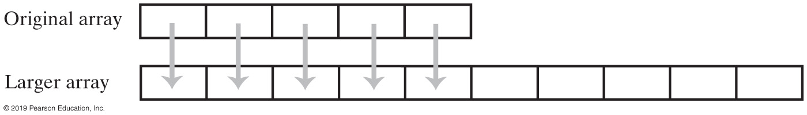
Resizing an Array
Because arrays are fixed-length structures, we will want to resize our array-based bag if we are full
One approach is when attempting to add a new entry, if we find the bag is full, we create a new bag of double the size, copy the old entries into the new bag, and add the new entry

Slide 37
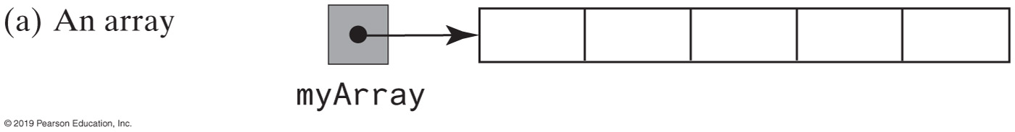
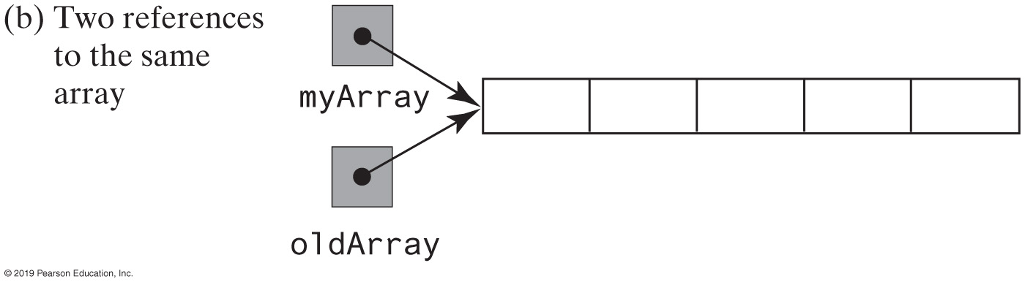
Resizing an Array
We can do this by: creating a temp reference to our array, allocate a new array of double the size, copy each entry from old array to new array, and delete the old array

Slide 38
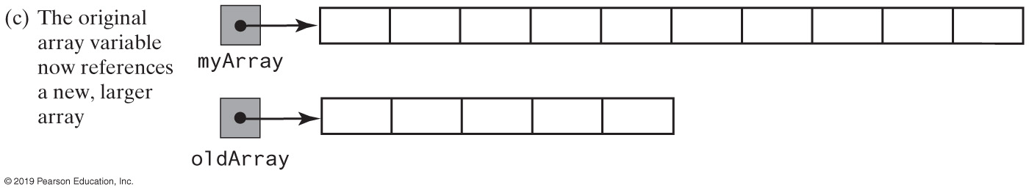
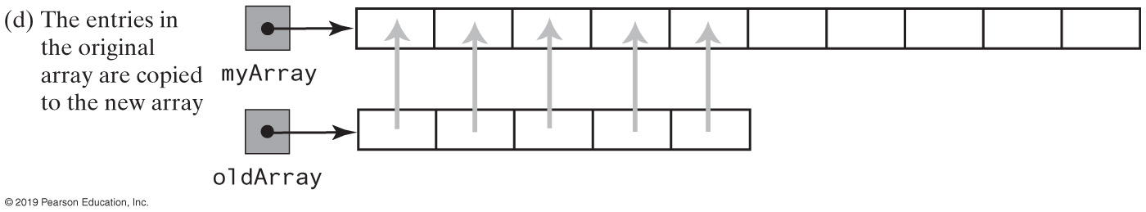
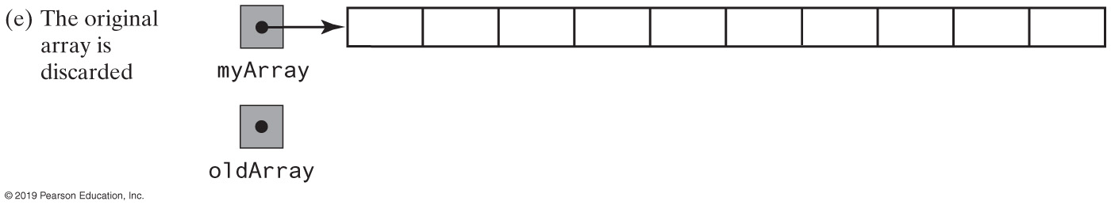
Resizing an Array

Slide 39
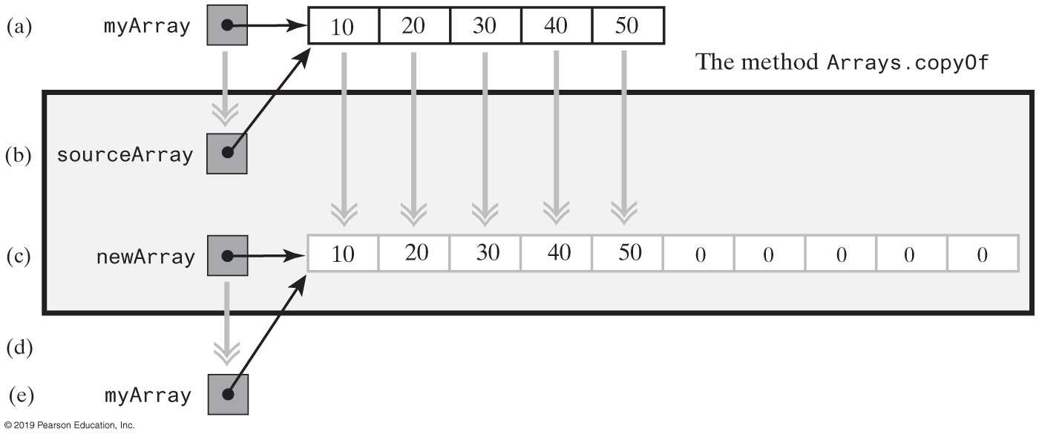
Resizing an Array
Alternate way: use existing code!
The Java Arrays class has a static copyOf(sourceArray, newLength) method that will do this for us!

Slide 40
Resizing an Array
Now, we can revise our add method
If the array is full, we call a helper method to double the capacity; then add new entry to the resized array
The doubleCapacity helper method will use Arrays.copyOf to create a resized copy of the old array

Slide 41
Summary of Array-Based Implementation
Adding an entry is fast
But if the bag needs to be resized, it takes time to copy the entries into the new resized array
Removing an unspecified entry is fast
Removing a particular entry requires time to locate the entry
Because arrays have fixed size, there is potential for wasted space and overhead for upkeep

Slide 42
Linked List-Based Implementation
An alternate implementation can use linked lists to house the entries
Unlike arrays, linked lists are dynamically allocated, with new entries linked to the existing entries as needed
When an entry is removed, the removed node can be spliced out and that memory can be freed up
But cannot directly reference a particular entry – will have to traverse the list

Slide 43
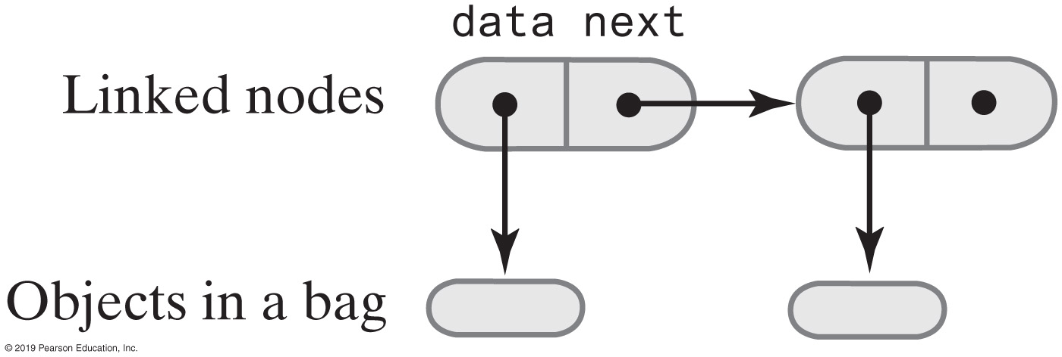
Nodes
A linked list is made up of Node objects
Node can be defined as a private class or use package protection and have it in the same package as the ListBag
Contains two parts:
The data (can use a generic type)
The next pointer to the next Node in the list

Slide 44
LinkedBag
From the list-level perspective, all we need is a reference to the first Node in the list (sometimes referred to as the head)
For ease of use, we can track the number of entries

Slide 45
Implementing the LinkedBag
We should follow the same approach as we did with the array-based implementation
Write the core methods (constructors, add, toArray) [note: no need to check if full… why not?]
Test the core methods
Move on to the other methods
getFrequencyOf
contains
remove
clear

Slide 46
Adding
We can insert a new entry at the beginning of the list (to save time) by adjusting the necessary pointers
New node's next points to the first node
First node pointer is re-assigned to the new node

Slide 47
Testing the Core Methods
Follow the same approach
Create a new bag and add some entries
Use helper display method to check it worked
Try adding a bunch of entries (helper method)
No need to worry about the bag being full (although we could theoretically run out of memory)

Slide 48
Removing
We can remove the entry by reassigning the pointers from the previous Node to point to the following Node
Two cases:
The entry to remove is the first Node
The entry to remove is not the first Node -- we can swap the entry to remove with the first entry, and then remove the first Node

Slide 49
Summary of List-Based Implementation
Advantages
Bag can grow and shrink in size as needed
Removing can free up memory that is no longer needed
Adding a new entry to the start of the chain is relatively easy
We can make removal relatively easy as well with our shortcut
Disadvantages
Removing a specific entry requires search of the chain
The List version will require more memory than an array version of the same size… Why?

